Slide 1
The Nerdlist
The totally not 1337 bad idea that gives n00bs a foot in the door
Wild West Hackin Fest
Deadwood, South Dakota
October 25, 2019

Slide 2
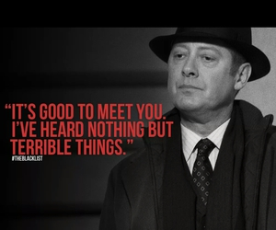

Slide 3
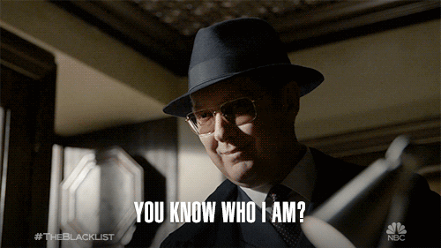
Notes:
I’m a NERRRRRRRD and this talk is going to be filled with some very, very bad puns. Here we go. This is a total ship of infosec and The Blacklist, and here’s why.

Slide 4
$whoami
Cybersecurity Policy Fellow at New America
Information security executive for public companies in offensive and defensive security
Policy advising and consulting for IGOs, NGOs, and political campaigns
Political scientist
Author of Women In Tech and multiple articles on cybersecurity, cyberwarfare, and risk management strategy in cybersecurity
Semipro poker player
Student pilot
Learning Italian
Hacker of things for fun and profit
Handwritten card aficionado
Cook
Notes:
MY BIOGRAPHY
Who am I? I’m a security researcher, senior security executive, author, poker player, and more.
I’m standing here because I’m weird. I’ve been in security as an academic, an industry cyber executive, an entrepreneur, a writer, and in government and policy advising. I’ve seen an immense focus on the practice and theory of security explode over the last 20 years as all the inventors suddenly realized that their creations could be jacked or even used as intended, but to abuse and harm others.

Slide 5
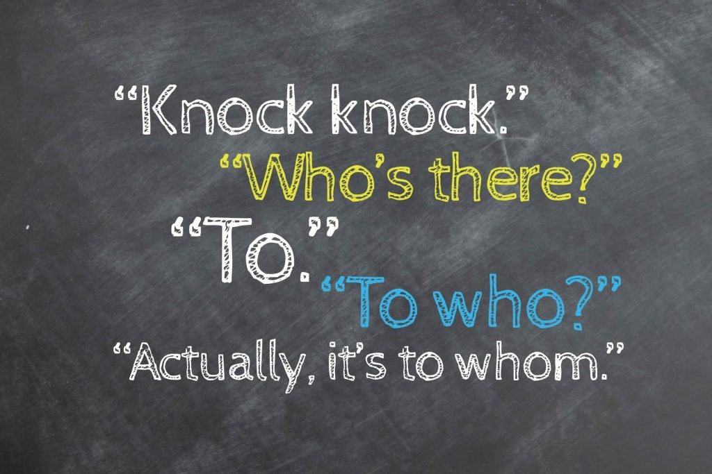
Inside Jokes + Nerds
The Nerdlist Project
Where Do We Go From Here
Notes:
OUTLINE SLIDE

Slide 6
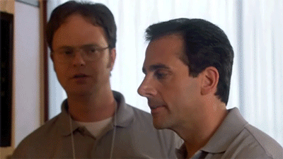
Inside Jokes + Nerds
The Nerdlist Project
Where Do We Go From Here
Notes:
BEGINNING OF TOPIC ONE

Slide 7
Inside Jokes + Nerds = <3

Slide 8
Why “The Blacklist”?
Notes:
There are a lot of shows about hackers that don’t say they’re about hackers.

Slide 9
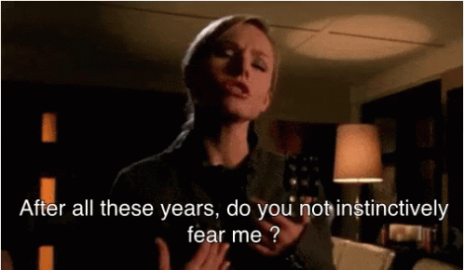
Notes:
There are a lot of shows about hackers that don’t say they’re about hackers.

Slide 10
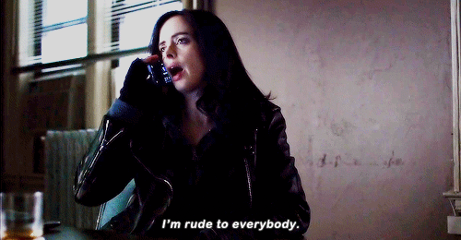
Notes:
There are a lot of shows about hackers that don’t say they’re about hackers.

Slide 11
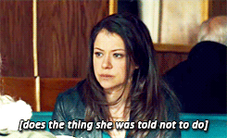
Notes:
There are a lot of shows about hackers that don’t say they’re about hackers.

Slide 12
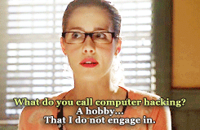
Notes:
There are a lot of shows about hackers that don’t say they’re about hackers.

Slide 13
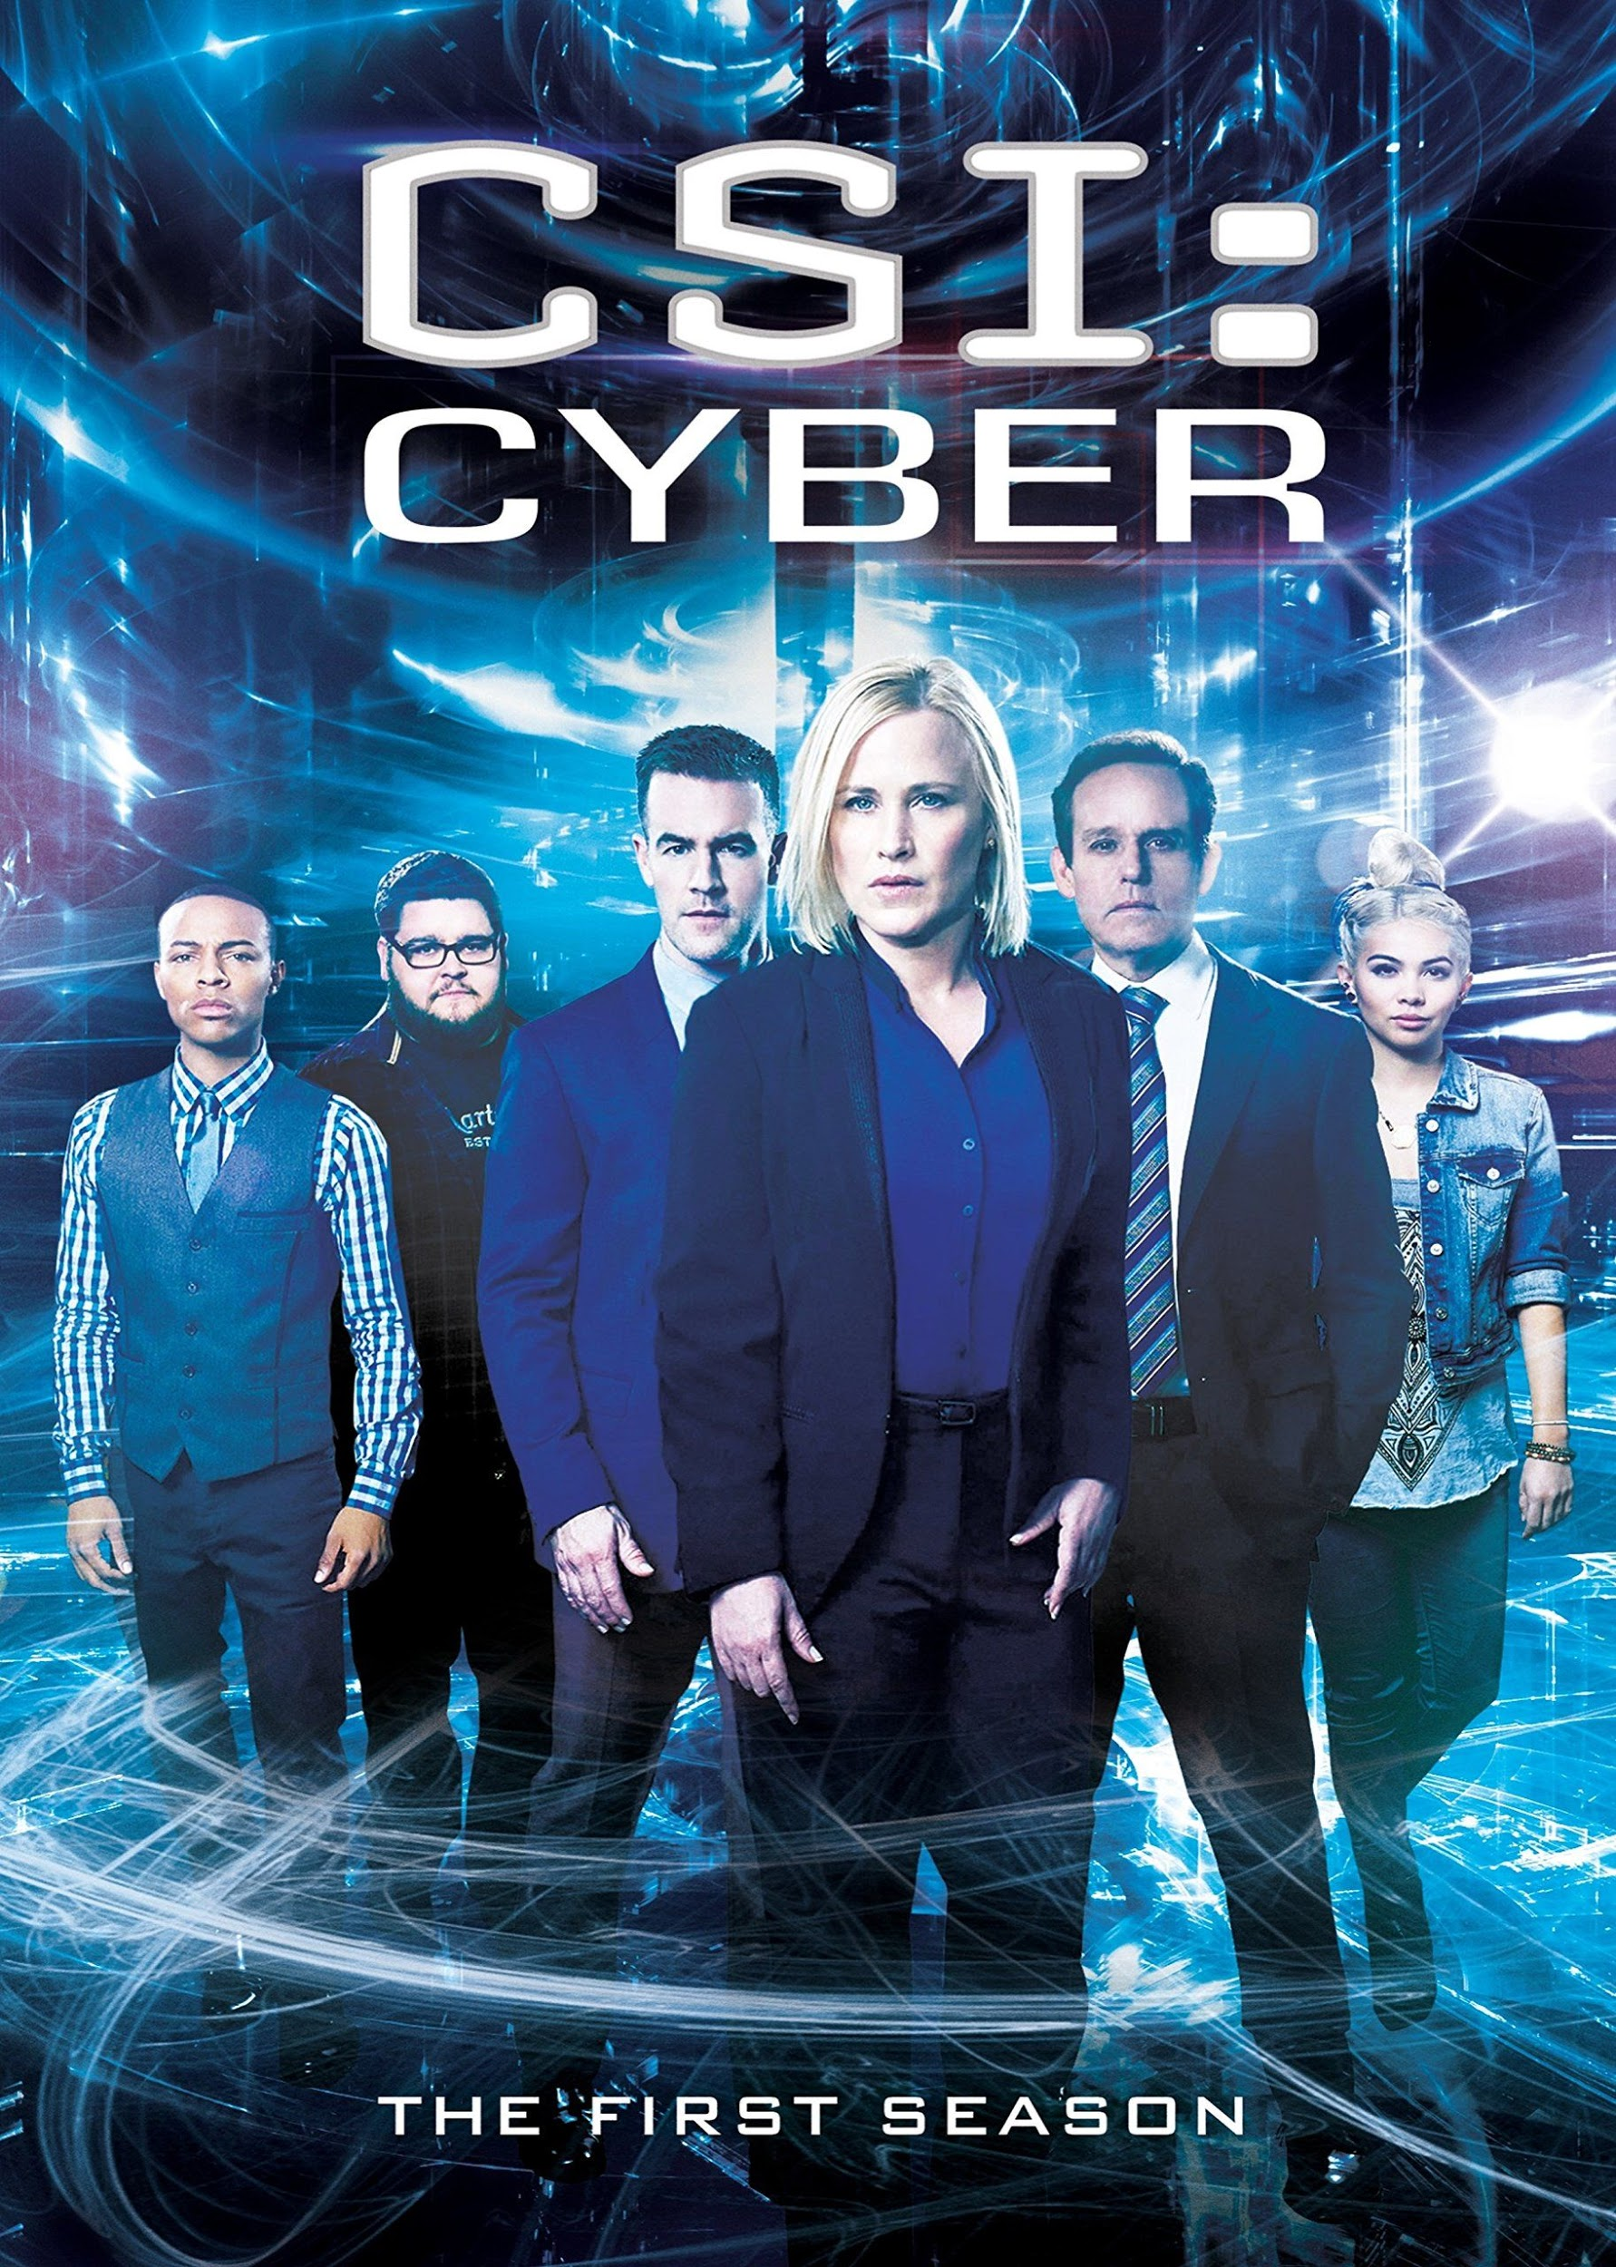

Notes:
And some shows that say they’re about hackers that aren’t at all about hackers.
For those in the room who are wondering about Veronica Mars, Jessica Jones, Orphan Black, and Felicity Smoak because they don’t seem to be relevant to you--I wonder what it would be like to see a talk that is filled with cultural references and a gender balance that is totally unrelated to you, and yet you must still find meaning in it?

Slide 14
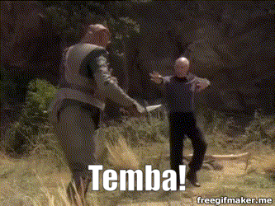
Notes:
Huh. I wonder what that would be like.

Slide 15
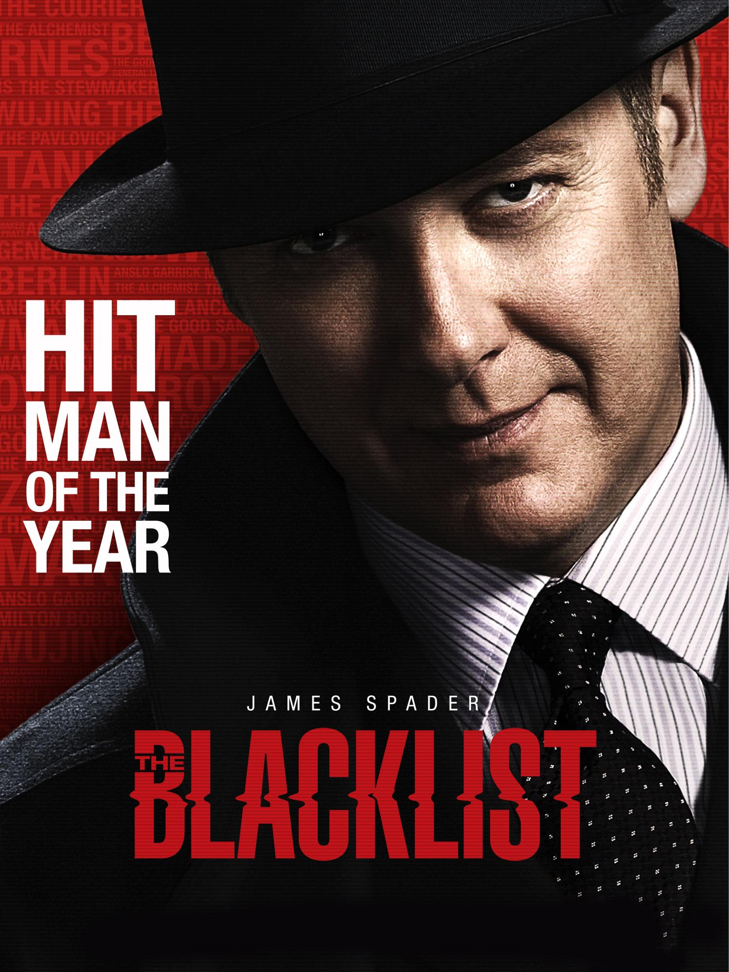
Notes:
The Blacklist is the most comprehensive hacking show on TV. It flat out is. The tech isn’t entirely completely ridiculous (but to be fair, Mr Robot’s tech is best and that’s because it’s the only show that listens to us. Well, CJ and DT, to be accurate, but that’ll do.).
Also, James Spader.

Slide 16
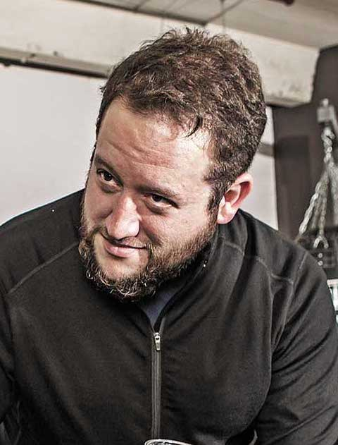
Notes:
Also it’s possible I have a type.

Slide 17
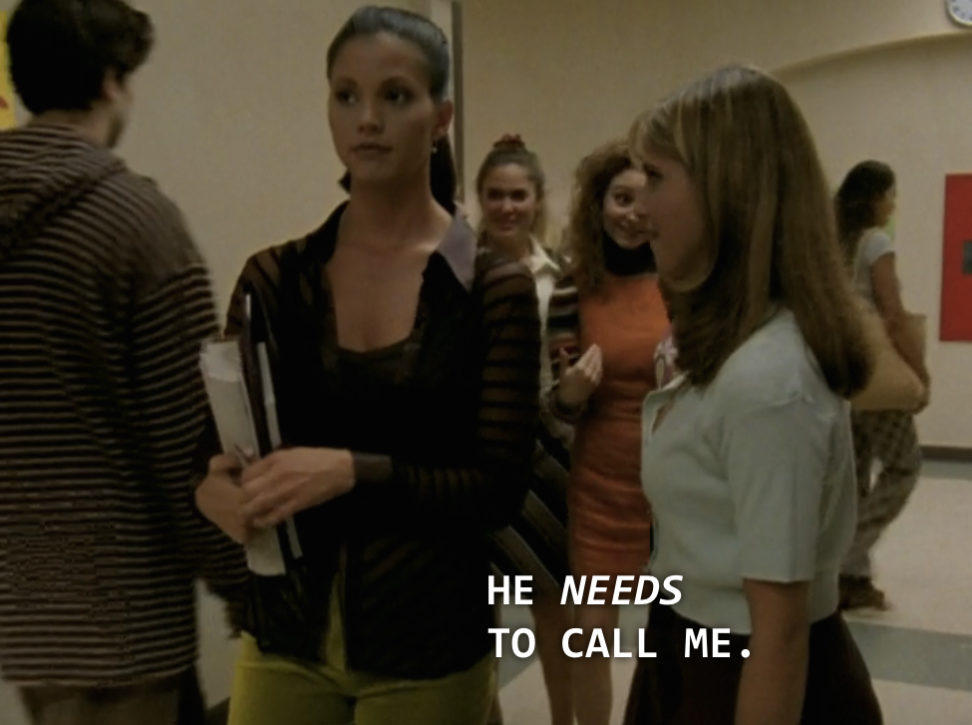
JAMES SPADER?
Notes:
He was a snack even when Buffy was on the air. Who remembers Welcome to the Hellmouth?

Slide 18
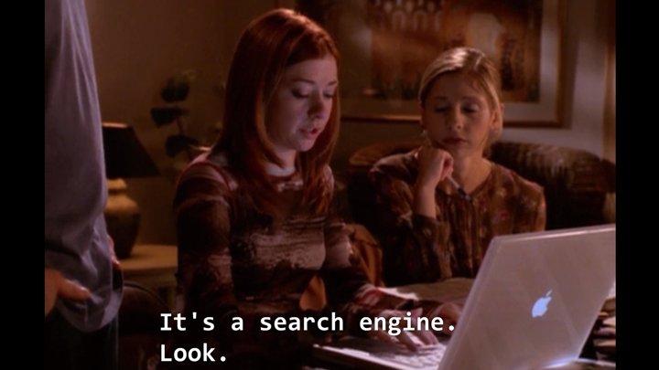
Notes:
Also, another shout out to the first lesbian hacker on tv.
For those of you who don’t know, Willow Rosenberg in Buffy The Vampire Slayer was the first person to verbify “Google” on television.

Slide 19

Notes:
The jokes, discovery, and techniques in this show as well as the relationships constantly in flux and deepening is very hax. Really, the whole show is a masterclass in Identity and Access Management.
But here’s the thing. I’m really kind of less a guns and breaking into places person, and more sort of….

Slide 20

Notes:
The mastermind.
So I had this idea that started cracking me up one time when I was watching this show and practicing credential stuffing on Hack The Box or something. Heh. Cracking me up. Hahahaa. I laugh at my own jokes.
(Also a very important thing to note here is that we’re wearing each other’s clothing. Seriously, that’s my leather jacket he’s got on right now.

Slide 21
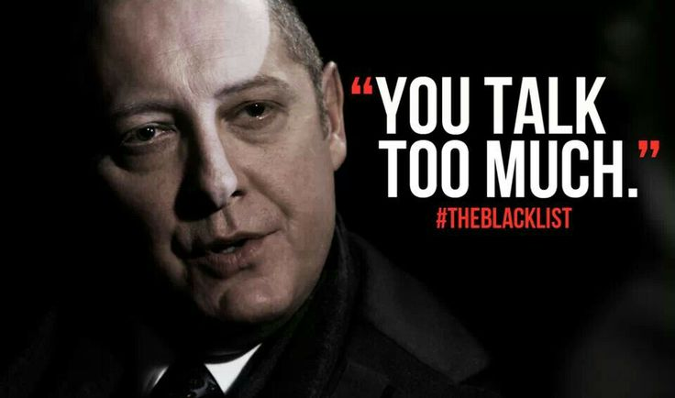

Slide 22

Inside Jokes + Nerds
The Nerdlist Project
Where Do We Go From Here

Slide 23
The Nerdlist Project

Slide 24
Other cracking lists
10-million-combos
RockYou.txt
CrackStation
Yandex
More

Slide 25
What’s the point of a new cracking list?
To welcome people into the first friendly security github. Let’s be honest--all the rest of them are terrifying, and women can’t get their contributions accepted at the same rate as men.

Slide 26
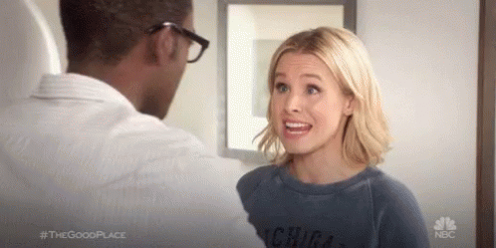
“Credential stuffing?
Notes:
Not really.
But this form of attack is so basic that I use it as an example of not actually tech when explaining the landscape for policymakers. We don’t even think of this as hacking anymore; it’s dull. However, it is valid, good practice, and helps people start with something very simple.

Slide 27
https://github.com/tarahmarie/nerdlist

Slide 28
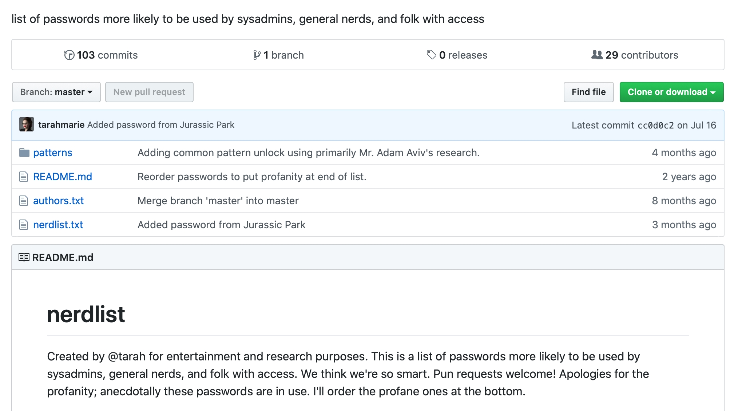

Slide 29
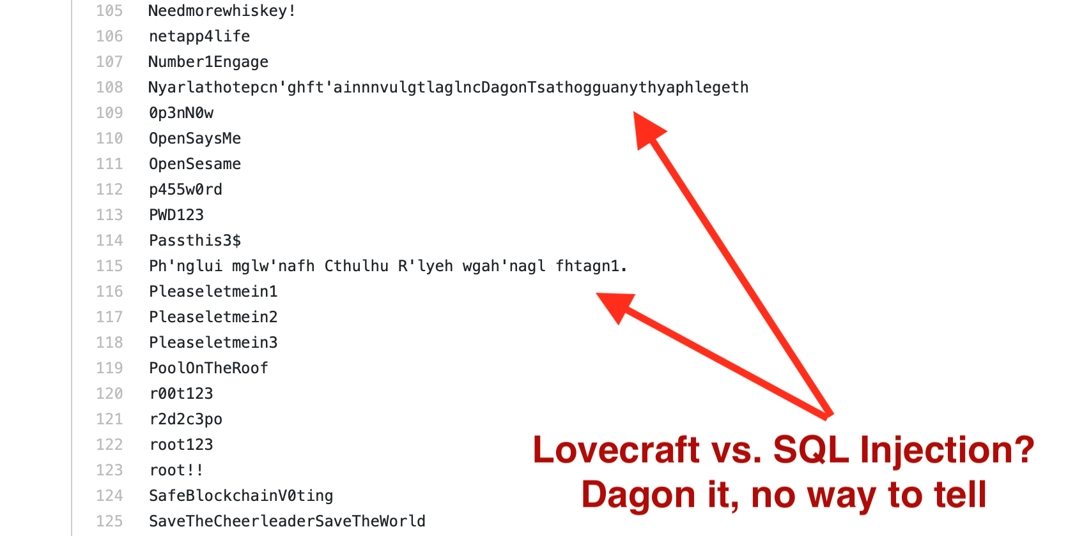

Slide 30

This project is an on-ramp...and it’s working.

Slide 31
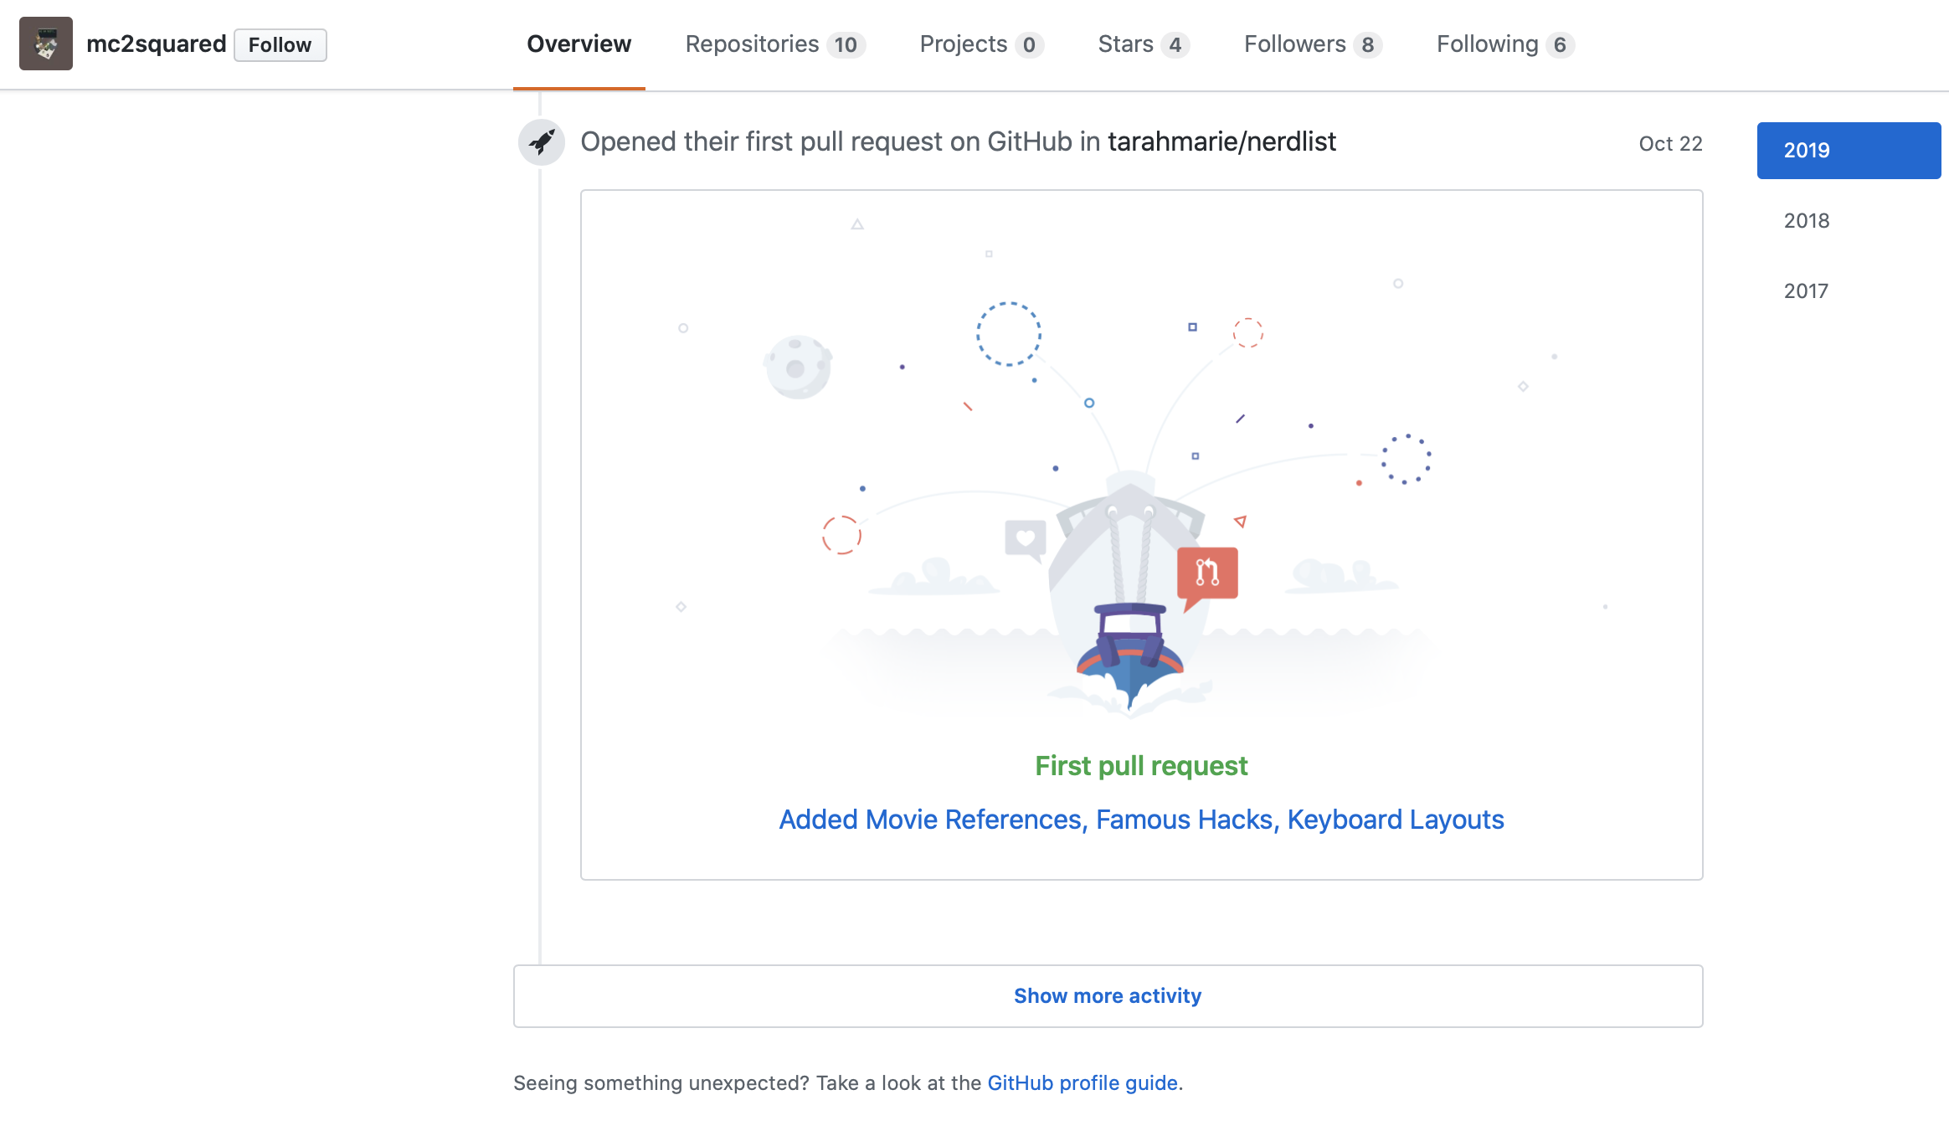
A high school girl’s first Github pull request.
Notes:
Maya Quinn is a high school girl with a damned impressive Github account...and you should follow her.
@BashingFash on Twitter.

Slide 32
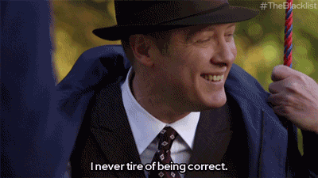
Notes:
I was just sure this was going to work.

Slide 33
If anyone says your contributions aren’t good enough...

Slide 34
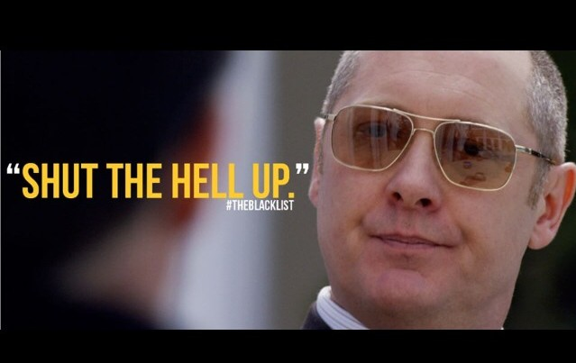

Slide 35
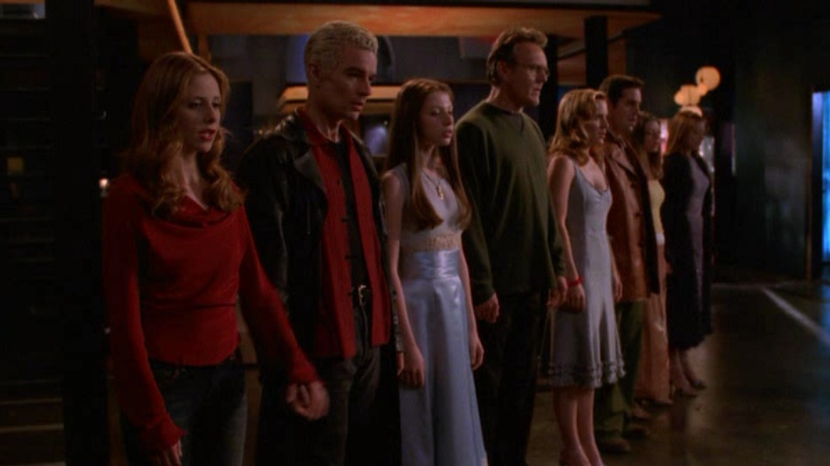
Inside Jokes + Nerds
The Nerdlist Project
Where Do We Go From Here

Slide 36
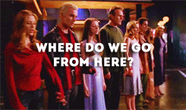
Where Do We Go From Here
Notes:
Where do we go from here
The battle’s done and we’ve kind of won
So we sound our victory cheer
Tell me
Where do we go, from here

Slide 37
Contribute
Coach
Crack
Notes:
The old chestnut that “this isn’t a sprint, it’s a marathon” is more true than most people realize...but it’s a triathlon that lasts your whole life, and you’ll never win it.
My mother is an Ironman. Yes, really. She once said that she asked one of the most elite cyclists in the world whether biking up mountains ever got less painful. The athlete said “it never hurts less. You just reach the top quicker.”
We didn’t choose this profession because it’s easy, but there are parts that are harder than others. Get to the top of the mountain faster.

Slide 38
Don’t know what to contribute?
Notes:
No idea where to start? Remember a love of puzzles.

Slide 39
What’s this, precious?
MD5
5f4dcc3b5aa765d61d8327deb882cf99

Slide 40
What’s this, precious?
MD5
Base64
5f4dcc3b5aa765d61d8327deb882cf99
cGFzc3dvcmQ=

Slide 41
What’s this, precious?
MD5
Base64
SHA1
5f4dcc3b5aa765d61d8327deb882cf99
cGFzc3dvcmQ=
5BAA61E4C9B93F3F0682250B6CF8331B7EE68FD8

Slide 42
What’s this, precious?
MD5
Base64
SHA1
ROT13
5f4dcc3b5aa765d61d8327deb882cf99
cGFzc3dvcmQ=
5BAA61E4C9B93F3F0682250B6CF8331B7EE68FD8
cnffjbeq

Slide 43
Orrrrr…..
Hashcat returns a result of “** NO PASSWORD **” when no result happens……….
………………..and that’s not on the list yet either.

Slide 44
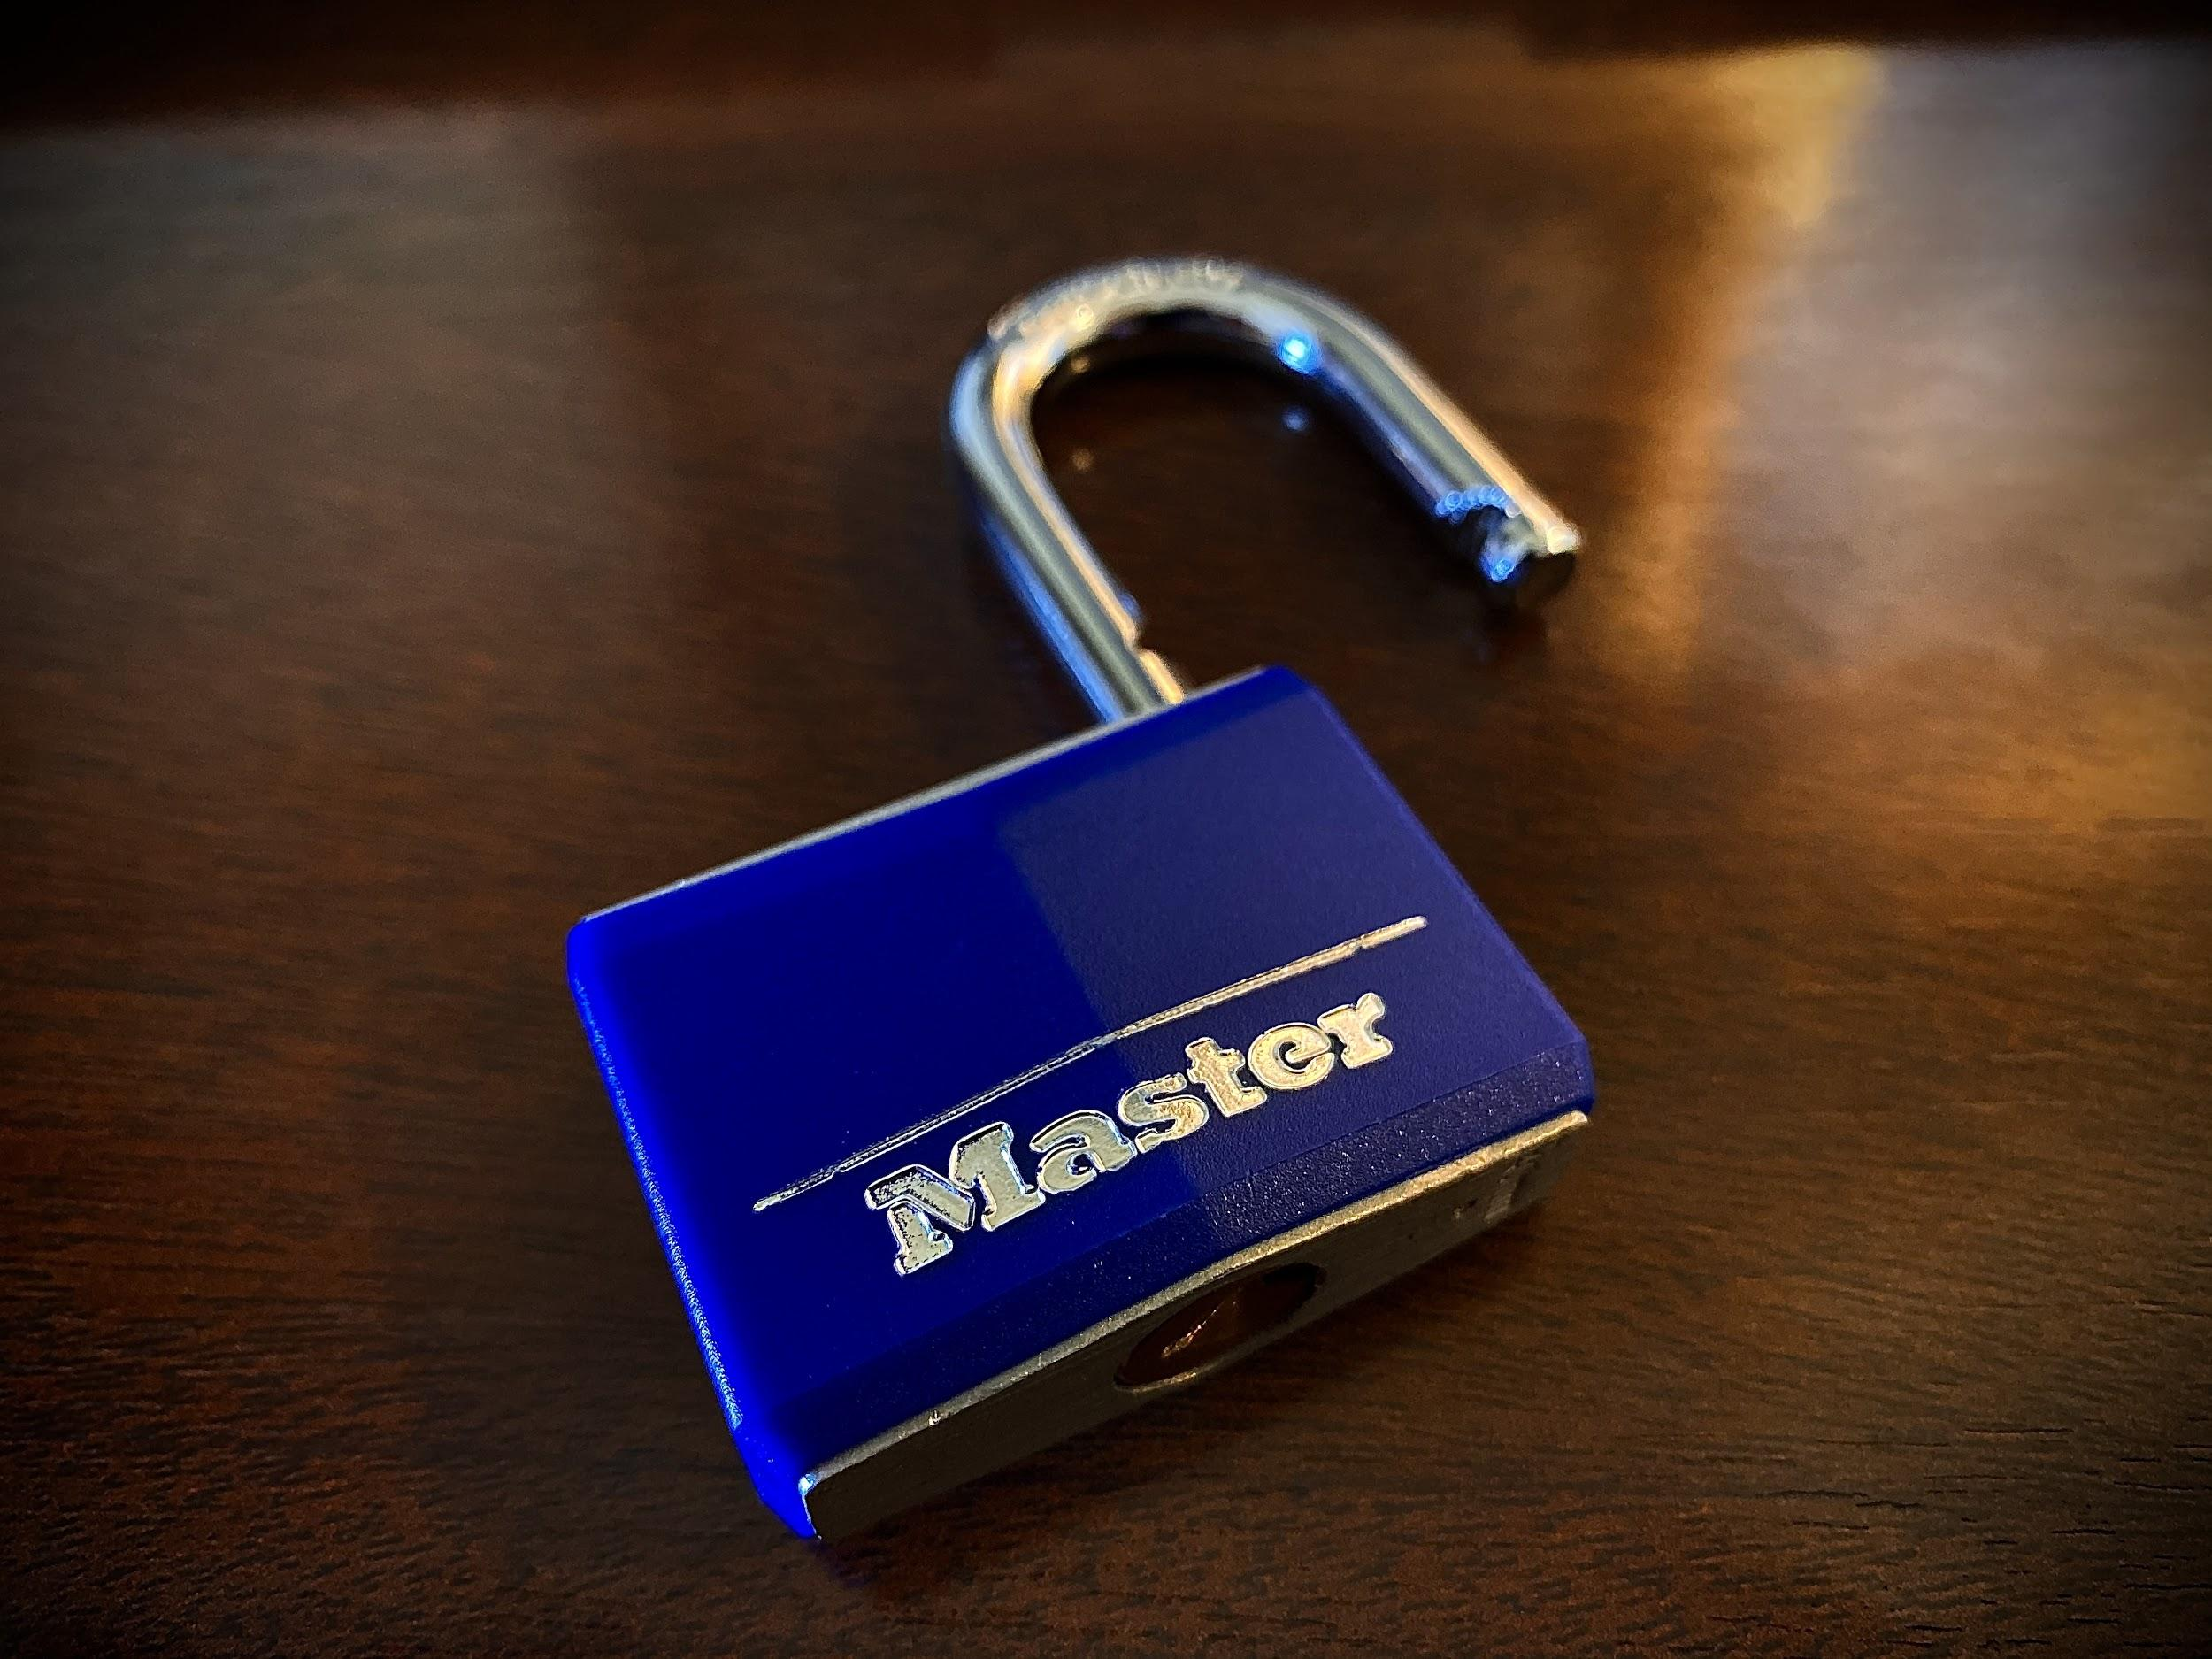
Coach.
Notes:
A slight tangent on why the communications, the metaphors, and the memes matter when we’re trying to communicate what we do to people not in our industry.
Master Lock 140 pick versus bypass
Policymakers, journalists, and nontechies. Analogies and physical implements are instantly understandable.
Here’s how I explain encryption backdoors and infrastructure SPOFs

Slide 45
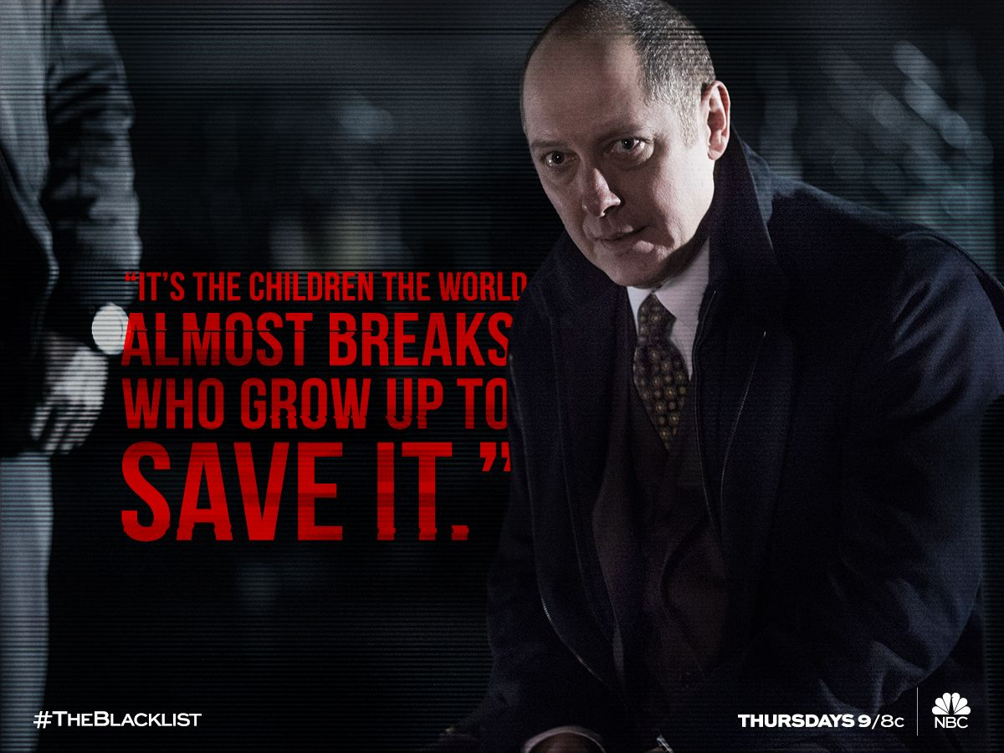

Slide 46
Crack all the things.

Slide 47
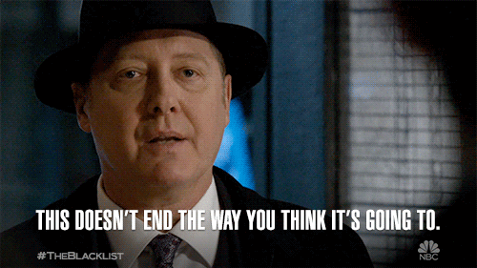

Slide 48
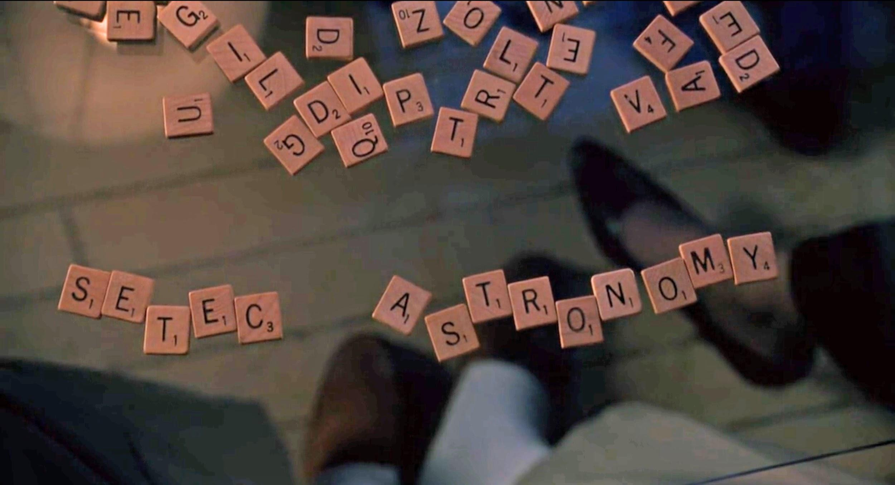

Slide 49
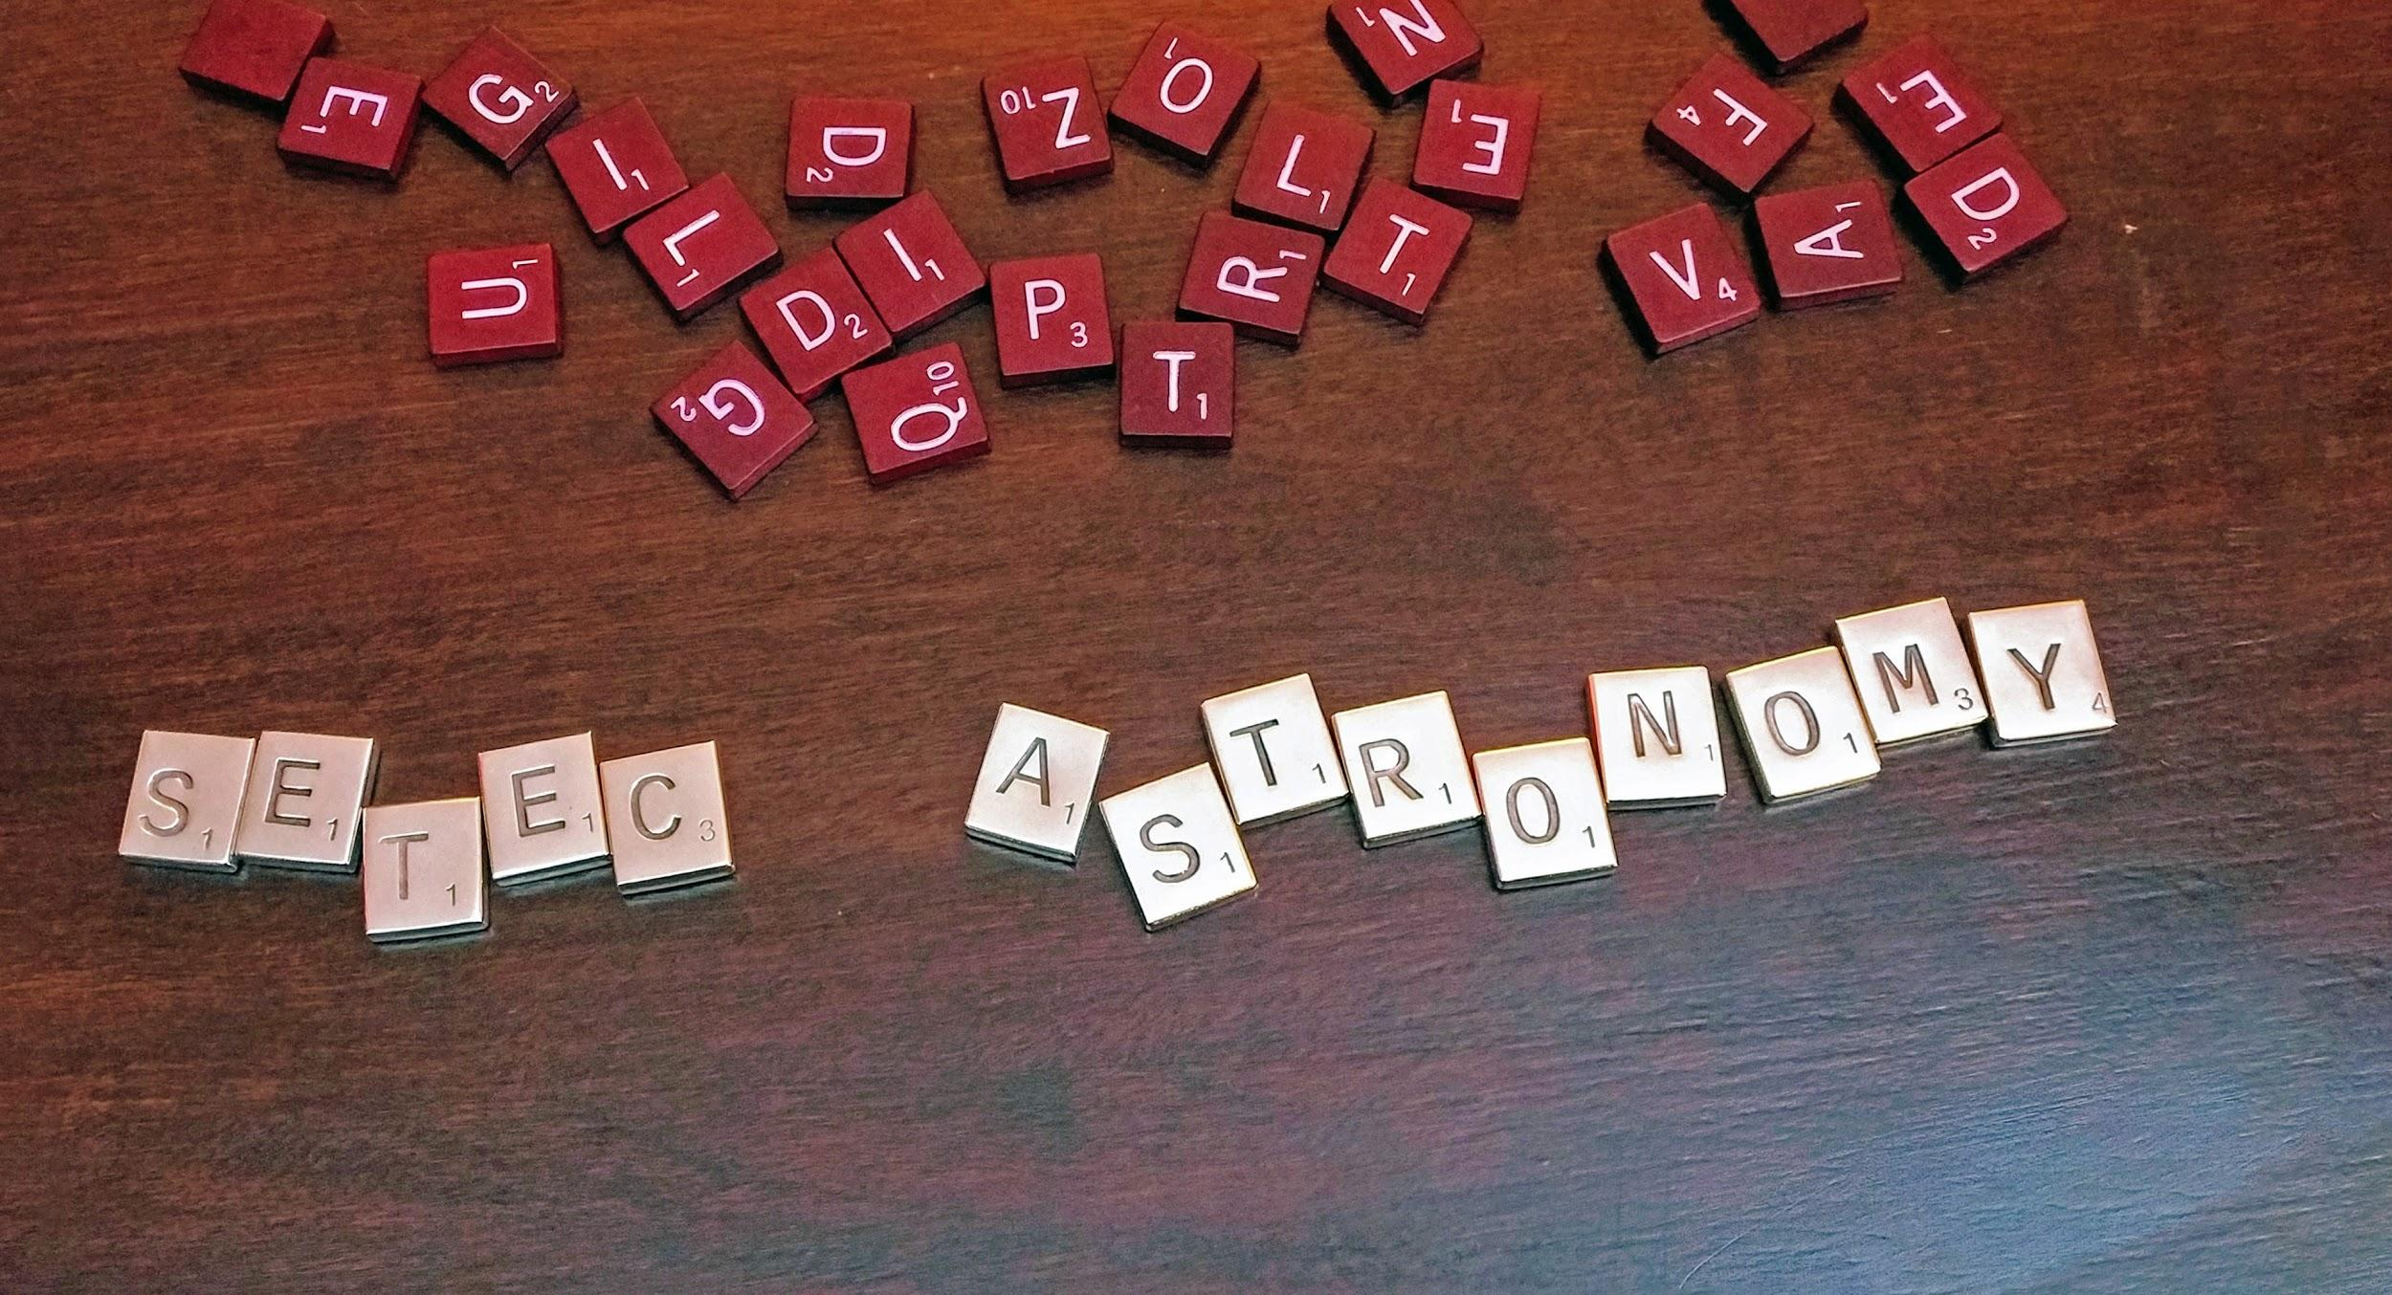

Slide 50
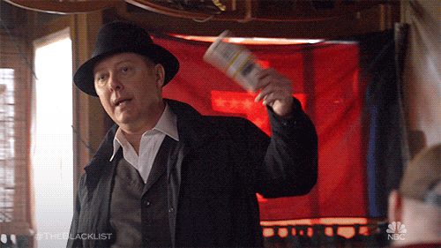
Notes:
Here’s the money. No...seriously, real precious metal.

Slide 51
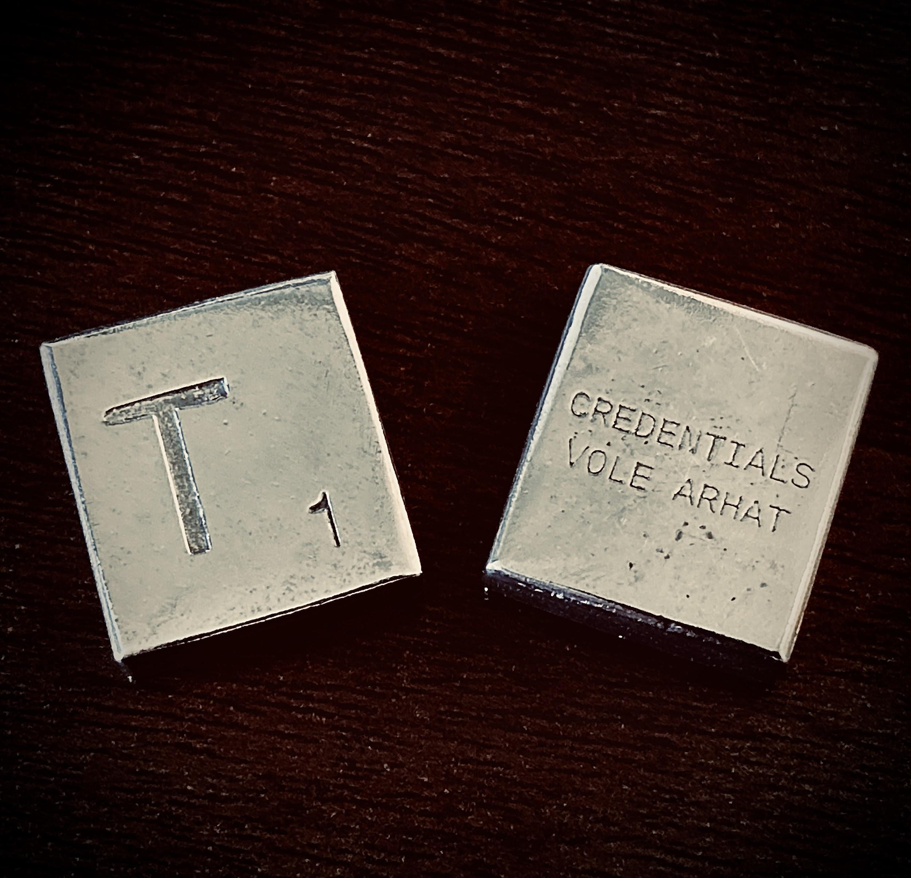
Challenge Coin
.999 Ag
Unique
Crack in the wild

Slide 52
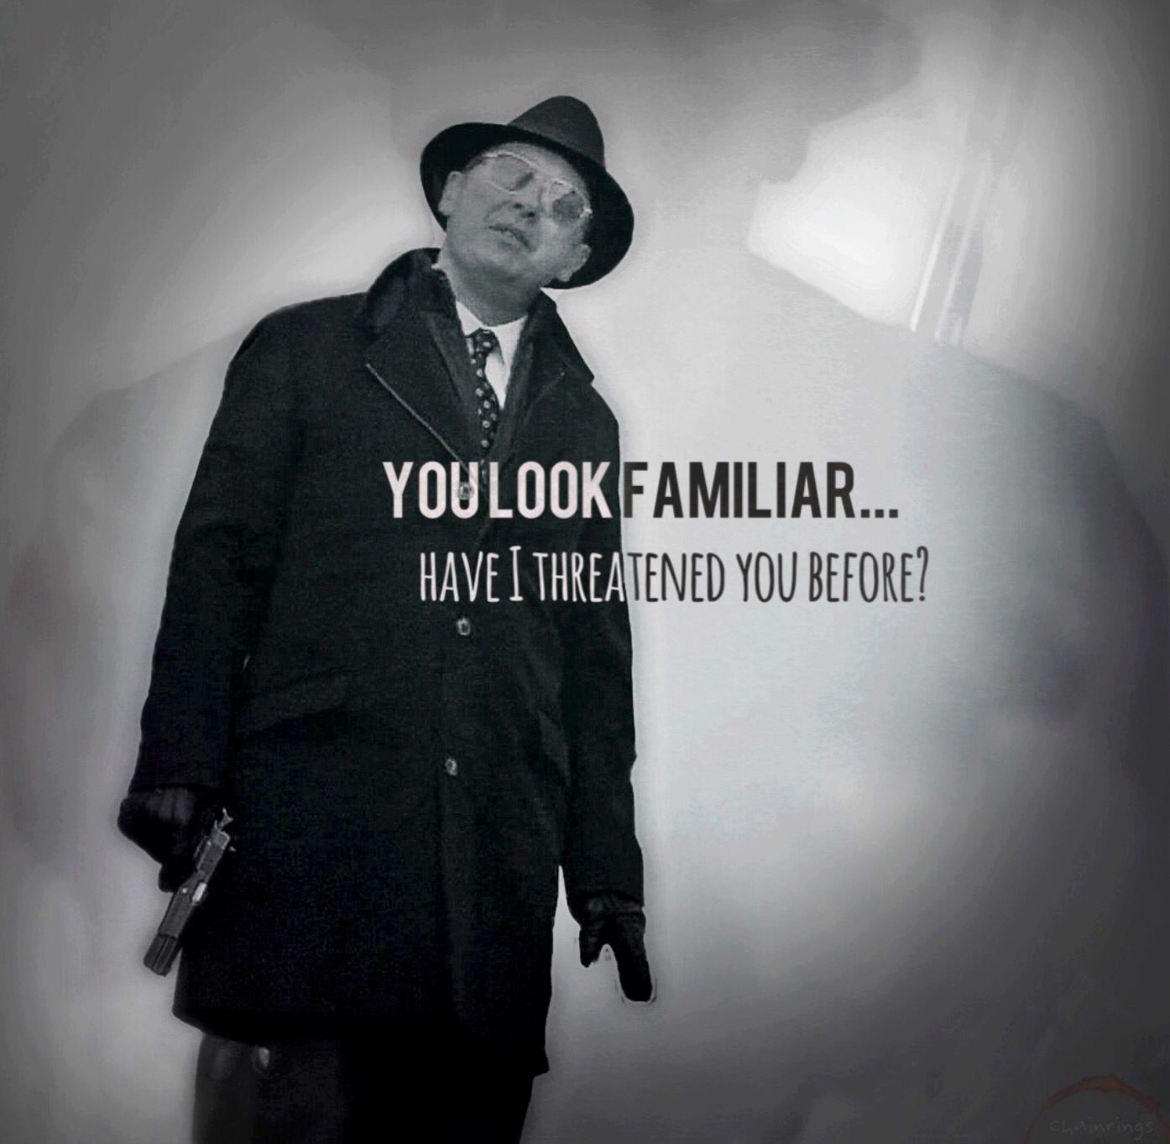
Notes:
I’m serious about the rules for this.

Slide 53
THE RULES
Legal
With permission
An it harm none, do as ye will
Private is ok, but must be verified by two trusted ppl
Proof to t@tarah.org

Slide 54
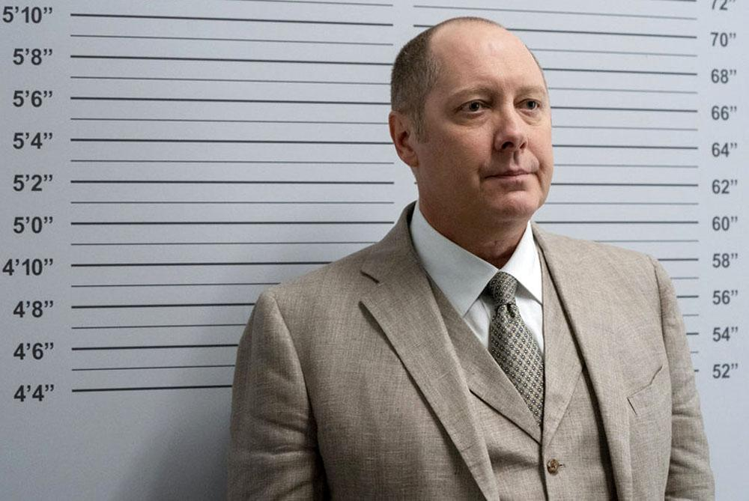
“What was that? The CFAA, you say?”
Notes:
Don’t break the rules. Marcia Hofmann can only do so many Pro Bono CFAA defenses, yall.

Slide 55
FOR HELP
Ask questions to @nerdlisting
#TheNerdlist
For Red’s sake: form teams!
Use Github Issues for discussion

Slide 56

This won’t end, ever.
So make it something that gets better over time.

Slide 57
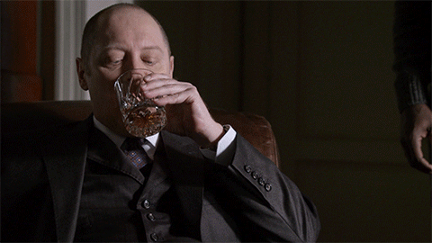

Slide 58
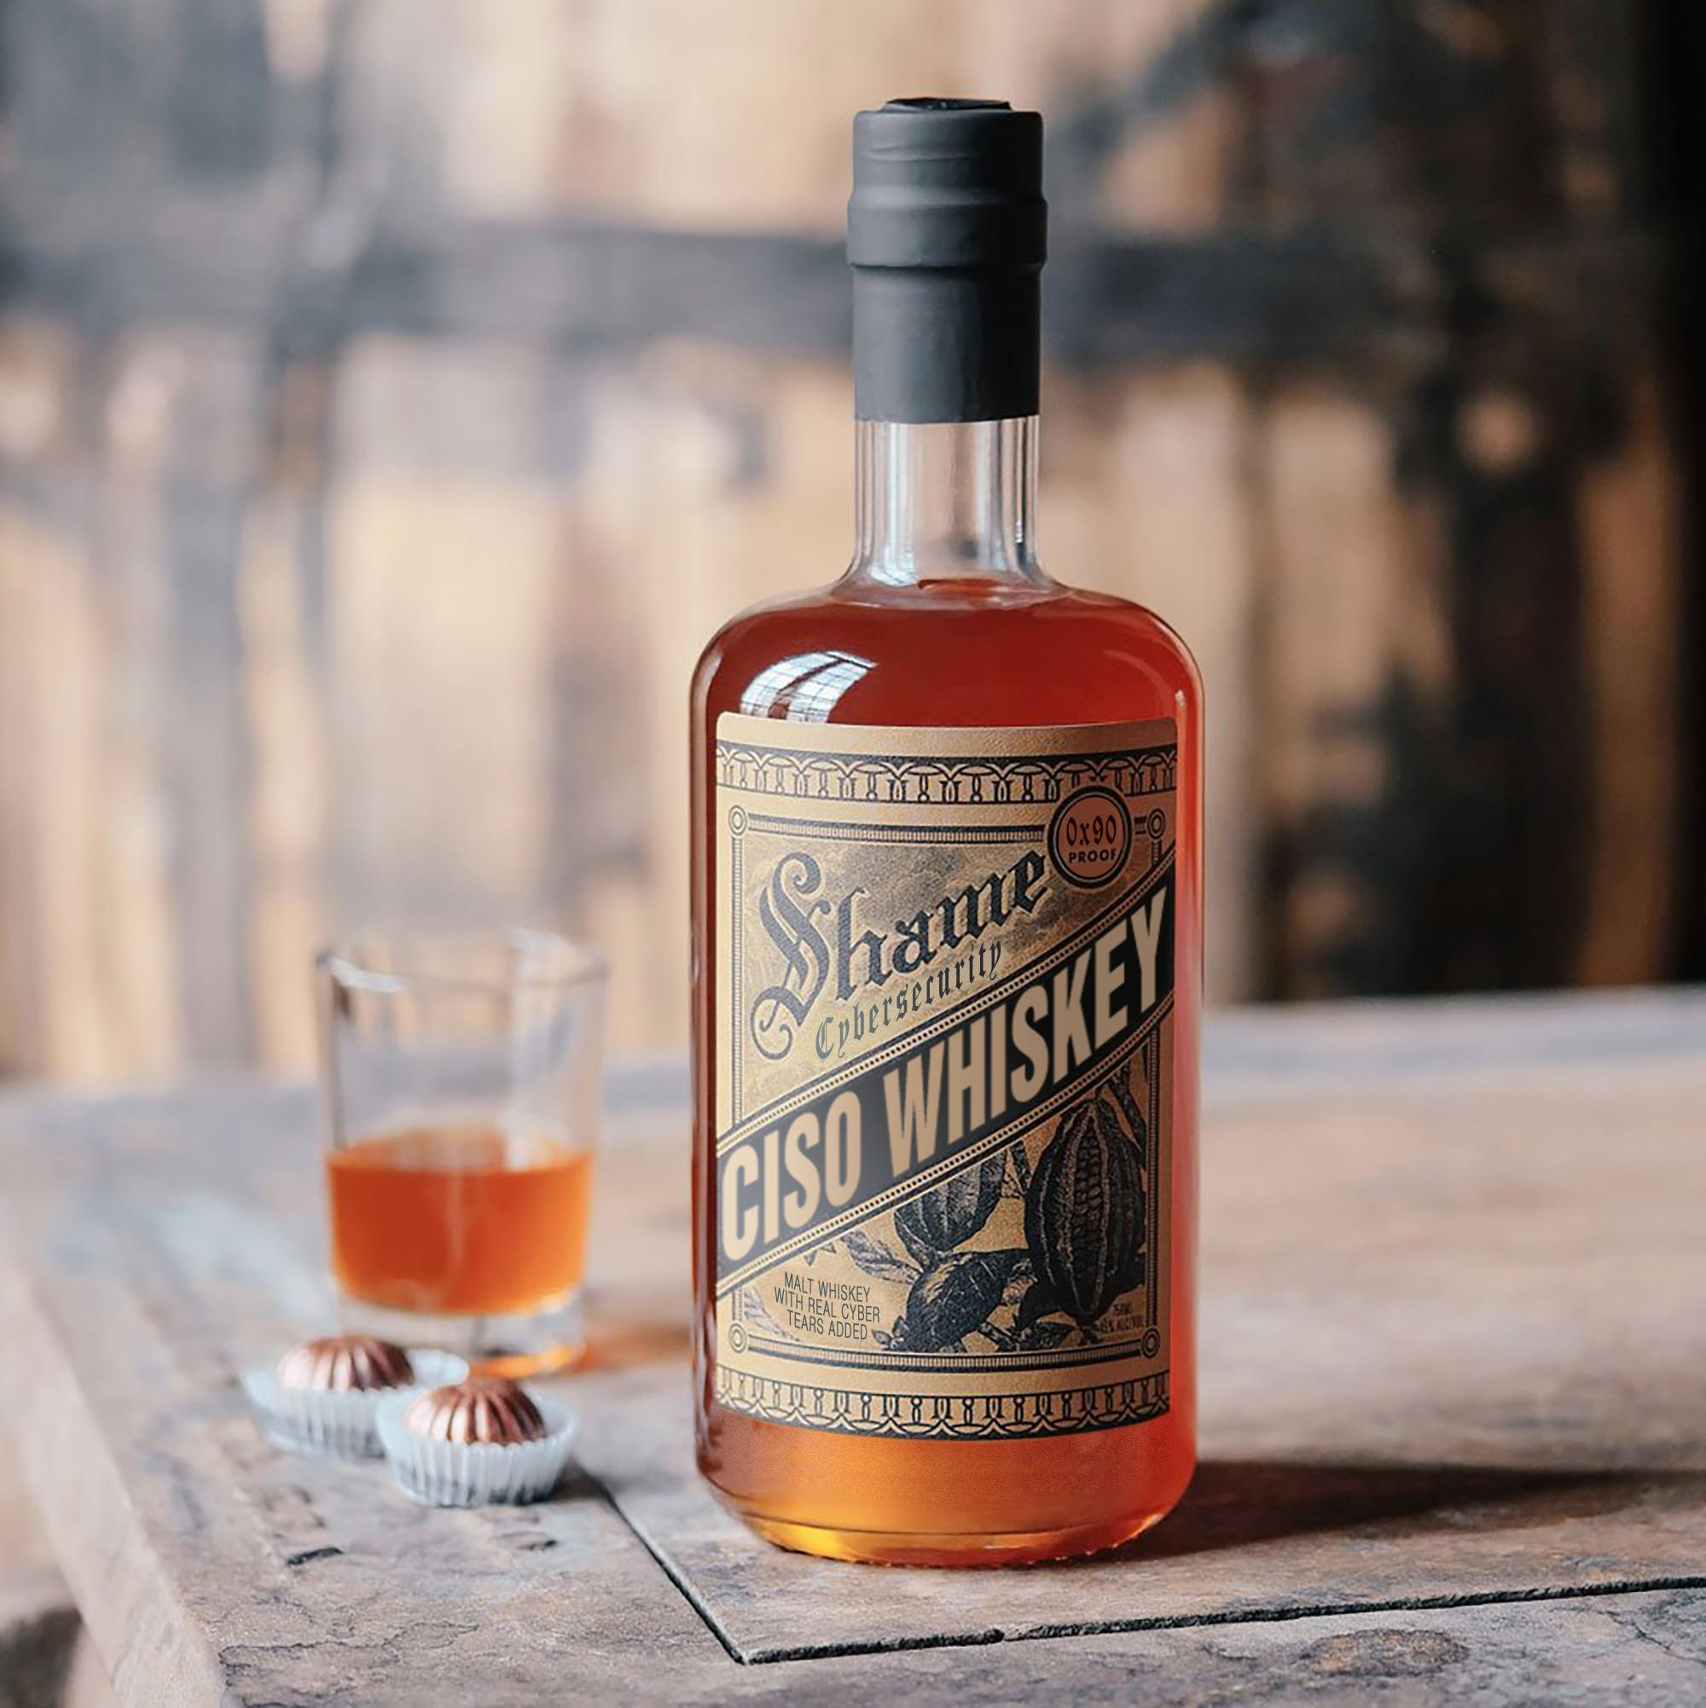
Notes:
This is not the answer. It’s delicious, but it’s not the answer.
The answer is calm, and knowing this too shall pass. The worst day of your life probably doesn’t have a lot to do with work. Neither does the best day. In two years, almost anything you do today will melt into a larger story of how you treated people with integrity and did your best and learned.

Slide 59
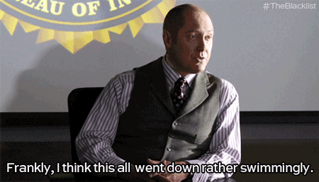

Slide 60
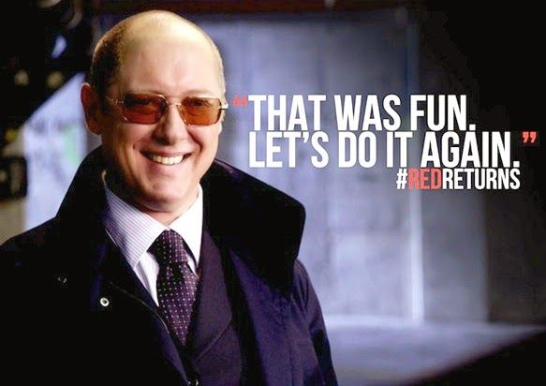
Notes:
I’m so honored to be invited back to speak here again.

